Slide 1
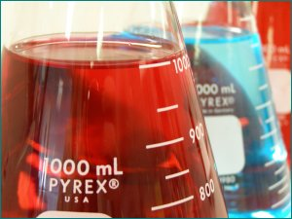
Chapter 10 – Chemical Quantities
Augustine.

Slide 2

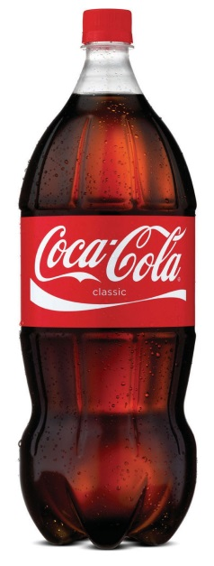
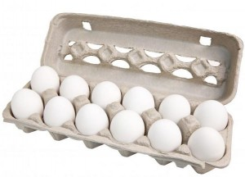
Section 10.1 – The Mole: A Measurement of Matter
You often measure the amount of something by count, by mass, or by volume.
A mole (mol) of a substance is 6.02 x 10²³ representative particles of that substance.
6.02 x 10²³ is called Avogadro’s number.
1 mole = 6.02 x 10²³ representative particles

Slide 3
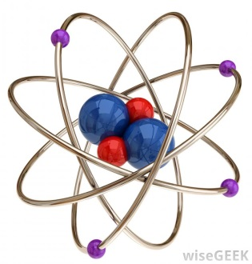
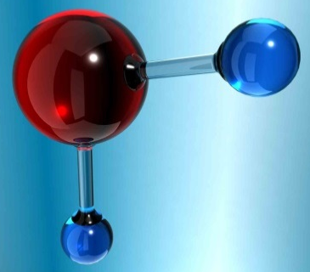
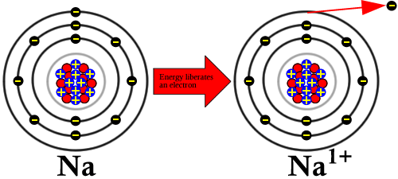
Representative Particles
A representative particle refers to the species present in a substance: usually atoms, molecules, or ions.
Elements normally exist as atoms, but 7 elements exist as diatomic molecules: H₂, N₂, O₂, F₂, Cl₂, Br₂, and I₂.
Be H₂O Na⁺

Slide 4
Sample Problem
How many moles is 2.80 x 10²⁴ atoms of silicon?
4.65 mol Si

Slide 5
Practice Problems
How many moles is 2.17 x 10²³ representative particles of bromine?
How many molecules are in 2.12 mol of propane? (m/c = molecules)
0.360 mole Br₂
1.28 x 10²⁴ m/c C₃H₈

Slide 6
Sample Problem
How many atoms are in 1.14 mol SO₃?
2.75 x 10²⁴ atoms

Slide 7
Practice Problems
How many moles are in 4.65 x 10²⁴ molecules of NO₂?
How many atoms are in 4.33 mol magnesium sulfate?
7.72 mol NO₂
1.564 x 10²⁵ atoms

Slide 8
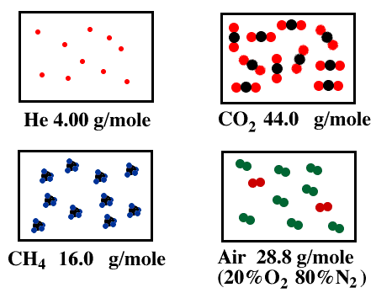
Molar Mass
The atomic mass of an element expressed in grams is the mass of a mole of the element.
The mass of a mole of an element is the molar mass.
To calculate the molar mass of a compound, find the number of grams of each element in one mole of the compound. Then add the masses of the elements in the compound.

Slide 9
Sample Problem
What is the molar mass of PCl₃?
137.5 g/mol

Slide 10
Practice Problems
What is the molar mass of sodium hydrogen carbonate?
What is the mass of calcium nitrate?
84 g/mol
164 g/mol

Slide 11
Section 10.1 Assessment
Describe the relationship between Avogadro’s number and one mole of any substance.
How can you calculate the mass of a mole of a compound?
How many moles is 1.50 x 10²³ molecules NH₃?
How many atoms are in 1.75 mol of CHCl₃?
What is the molar mass of CaSO₄?
0.249 mol NH₃
5.27 x 10²⁴ atoms
136.2 g/mol

Slide 12

Section 10.2 – Mole-Mass and Mole-Volume Relationships
You can use the molar mass of a substance as a conversion factor to convert between moles and mass.
1 mole = molar mass

Slide 13
Sample Problem
What is the mass of 9.45 mol of alumiunum oxide?
964 g Al₂O₃

Slide 14
Practice Problems
Find the mass, in grams, of 4.52 x 10⁻³ mol C₂₀H₄₂.
Calculate the mass of 2.50 mol of iron (II) hydroxide.
Calculate the number of moles in 75.0g of dinitrogen trioxide.
1.27g C₂₀H₄₂
225g Fe(OH)₂
0.987 mol N₂O₃

Slide 15
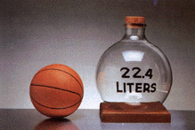
Volume
Avogadro’s hypothesis states that equal volumes of gases at the same temperature and pressure contain equal numbers of particles.
At STP, 1 mole of any gas occupies a volume of 22.4L.
STP = standard temperature (0ºC) and pressure (1 atm)

Slide 16

Volume
The volume of a gas changes with temperature and pressure, so 22.4L can only be used if the gas is at STP.
1 mol = 22.4L

Slide 17
Sample Problem
Determine the volume, in liters, of 0.60 mol of SO₂ gas at STP.
13L SO₂

Slide 18
Practice Problems
What is the volume of 3.70 mol N₂ at STP?
How many moles is in 127L of CO₂ at STP?
82.9L N₂
5.67 mol CO₂

Slide 19
Mole Conversion Factors
Now you have 3 conversion factors for moles:
1 mol = 6.02 x 10²³ r.p. (for atoms, m/c, or ions)
1 mol = molar mass (for grams or mass)
1 mol = 22.4L (for liters or volume)

Slide 20
Section 10.2 Assessment
What is the volume of one mole of any gas at STP?
How many grams are in 5.66 mol of calcium carbonate?
Find the number of moles in 508g of ethanol (C₂H₅OH).
Calculate the volume, in liters, of 1.50 mol chlorine at STP.
567g CaCO₃
11 mol C₂H₅OH
33.6L Cl₂

Slide 21
Section 10.2 Assessment
Three balloons filled with 3 different gaseous compounds each have a volume of 22.4L at STP. Would these balloons have the same mass or contain the same number of molecules? Explain.

Slide 22
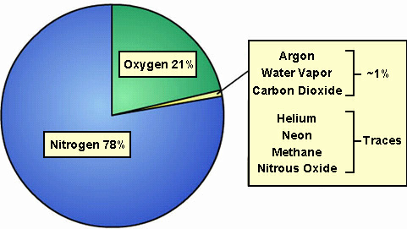
Section 10.3 – Percent Composition and Chemical Formulas
The percent by mass (percent composition) of an element in a compound is the number of grams of the element divided by the mass in grams of the compound multiplied by 100%.
% mass of element = mass of element x 100
mass of compound

Slide 23
Sample Problem
When a 13.60g sample of a compound containing only magnesium and oxygen is decomposed, 5.40g of oxygen is obtained. What is the percent composition of this compound?
Mg = 60.3%
O = 39.7%

Slide 24
Practice Problems
A compound formed when 9.03g Mg combines completely with 3.48g N. What is the percent composition of this compound?
When a 14.2g sample of mercury (II) oxide is decomposed into its elements by heating, 13.2g of Hg is obtained. What is the percent composition of this compound?
Mg = 72.2%, N = 27.8%
Hg = 93%, O = 7%

Slide 25
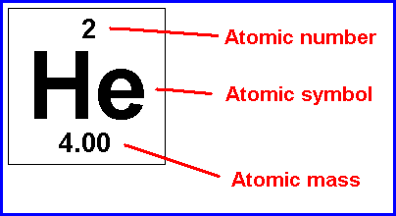
Percent Composition
If a percent composition problem does not give you the exact masses of the elements, then you can use the molar masses instead.
Use the same formula for percent composition.

Slide 26
Sample Problem
Calculate the percent composition of propane (C₃H₈).
C = 81.8%
H = 18%

Slide 27
Practice Problems
Calculate the percent composition of sodium hydrogen sulfate.
Calculate the percent composition of NITROGEN in ammonium nitrate.
Na = 19.2%, H = 0.83%, S = 26.7%, O = 53.3%
N = 35%N

Slide 28
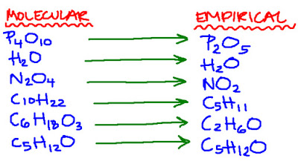
Chemical Formulas
The molecular formula is the actual formula for a molecular compound. It contains the actual number of each type of atom.
The empirical formula is the lowest whole-number ratio of atoms in a molecular compound.
C₆H₁₂O₆ → CH₂O
m.f. e.f.

Slide 29

Empirical Formula
Sometimes the empirical formula is the same as the molecular formula. Ex: H₂O
To calculate the empirical formula, you follow 3 steps:
Change % to grams.
Convert grams to moles.
Divide each number by the smallest answer.

Slide 30
Sample Problem
Calculate the empirical formula for a compound that is 67.6% Hg, 10.8% S, and 21.6% O.
HgSO₄

Slide 31
Practice Problems
Calculate the empirical formula for the following:
94.1% O and 5.9% H
62.1% C, 13.8% H, and 24.1% N
OH
C₃H₈N

Slide 32
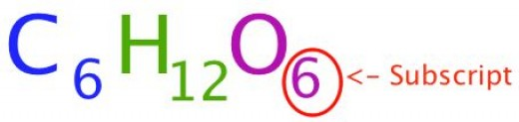
Empirical Formula
After step 3, you should get whole numbers that can be used as the subscripts.
Sometimes you will get a number that ends in .5 or .33. Do NOT round these numbers.
For .5, multiply all answers by 2.
For .33, multiply all answers by 3.

Slide 33
Sample Problem
A compound is analyzed and found to contain 25.9% nitrogen and 74.1% oxygen. What is the empirical formula of the compound?
N₂O₅

Slide 34
Practice Problem
Determine the empirical formula for a compound that is 50.7% C, 4.2% H, and 45.1% O.
C₃H₃O₂

Slide 35
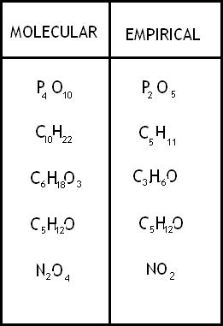
Molecular Formula
An empirical and molecular formula differ by a whole-number multiple, so their masses also differ by the same whole-number multiple.
m.f. e.f.
C₆H₁₂O₆ → CH₂O
180 g/mol → 30 g/mol
Multiplier = 6

Slide 36
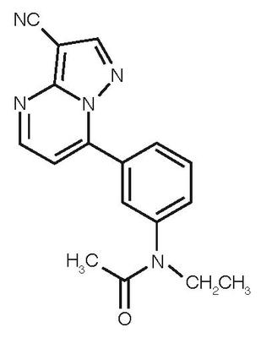
Molecular Formula
Whole-number multiplier = mass of m.f.
mass of e.f.

Slide 37
Sample Problem
Calculate the molecular formula of a compound whose molar mass is 60g/mol and empirical formula is CH₄N.
C₂H₈N₂

Slide 38
Practice Problems
Find the molecular formula for antifreeze with a molar mass of 62 g/mol and an empirical formula of CH₃O.
What is the molecular formula for a compound with a molar mass of 90 g/mol and an empirical formula of CH₂O?
C₂H₆O₂
C₃H₆O₃

Slide 39
Section 10.3 Assessment
How do you calculate the percent by mass of an element in a compound?
What information can you obtain from an empirical formula?
How is the molecular formula of a compound related to its empirical formula?
Calculate the percent composition of calcium acetate.
Ca = 25.4%, C = 30.4%, H = 3.8%, O = 40.5%

Slide 40
Section 10.3 Assessment
The compound methyl butanoate has a percent composition of 58.8% C, 9.8% H, and 31.4% O and its molar mass is 102 g/mol. What is its empirical and molecular formula?
Which of the following molecular formulas are also empirical formulas?
a. C₅H₁₀O₅ c. C₅₅H₇₂MgN₄O₅
b. C₆H₁₂O₂ d. C₁₂H₁₇ON
e.f. = C₅H₁₀O₂ m.f. = C₅H₁₀O₂

Slide 41
THE END

